Slide 1
LAAO: do we miss too much?
Akmal Yakubov - UZBEKISTAN

Slide 2
A
B
C
^{nticoagulation}
avoid stroke
^{etter}
symptom control
omorbidities
CV risk factor management
↯
⇪
⥈
1. Identify low-risk patients CHA2DS2-VASc 0(m), 1(f)
2. Offer stroke prevention if CHA2DS2-VASc ≥1(m), 2(f)
Assess bleeding risk, address modifiable bleeding risk factors
3. Choose OAC (NOAC or VKA with well-managed TTR)
Assess symptoms, QoL and patient’s preferences
Optimize rate control
Consider a rhythm control strategy (CV, AADs, ablation)
Comorbidities and cardiovascular risk factors
Lifestyle changes (obesity reduction, regular exercise, reduction of alcohol use, etc.)
2020 ESC Guidelines for the diagnosis and management of atrial fibrillation, Gerhard Hindrickset.al., European Heart Journal, Volume 42, Issue 5, 1 February 2021, Pages 373–498
Notes:
At the beginning of the management of patients with AF stays ANTICOAGULATION. Why? Because one of the most severe complication of AF is stroke, and AF associated strokes tend to be more disabling when compared to non AF related strokes

Slide 3
A
C
^{nticoagulation}
avoid stroke
↯
AVOID STROKE: what we can do?
1. Identify low-risk patients CHA2DS2-VASc 0(m), 1(f)
2. Offer stroke prevention if CHA2DS2-VASc ≥1(m), 2(f)
Assess bleeding risk, address modifiable bleeding risk factors
3. Choose OAC (NOAC or VKA with well-managed TTR)
2020 ESC Guidelines for the diagnosis and management of atrial fibrillation, Gerhard Hindrickset.al., European Heart Journal, Volume 42, Issue 5, 1 February 2021, Pages 373–498
Notes:
Soo, First of all, we should avoid stroke.

Slide 4
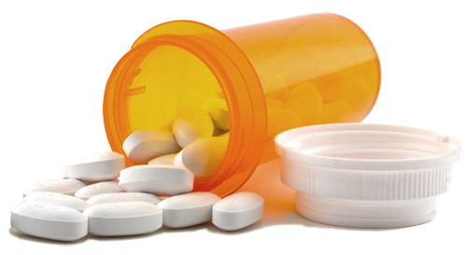
Stroke prevention methods
ANTICOAGULANTS
Recommendations for the prevention of thromboembolic events in AF
2020 ESC Guidelines for the diagnosis and management of atrial fibrillation, Gerhard Hindrickset.al., European Heart Journal, Volume 42, Issue 5, 1 February 2021, Pages 373–498
Notes:
Oral anticoagulants are currently the gold standard for reducing ischemic stroke risk in AF patients. This is so called systemic approach. Despite the clinical efficacy, many patients with AF have relative or absolute contraindications for long-term OAC because of perceived risk of major bleeding, poor compliance, and costs. These patients who do not receive OAC remain unprotected and have a significant risk of stroke and systemic thromboembolism

Slide 5
A
A
B
C
^{nticoagulation}
avoid stroke
↯
stroke
13 %
87 %
ISCHEMIC
Hemmoragic
1. Identify low-risk patients CHA2DS2-VASc 0(m), 1(f)
2. Offer stroke prevention if CHA2DS2-VASc ≥1(m), 2(f)
Assess bleeding risk, address modifiable bleeding risk factors
3. Choose OAC (NOAC or VKA with well-managed TTR)
2020 ESC Guidelines for the diagnosis and management of atrial fibrillation, Gerhard Hindrickset.al., European Heart Journal, Volume 42, Issue 5, 1 February 2021, Pages 373–498
Notes:
Approximately, 90 % of intracardiac thrombi originate in the left atrial appendage in AF patients. Eliminating the left atrial appendage by occluding or excluding is another method to reduce AF related ischemic stroke risk. It’s so called private approach.

Slide 6
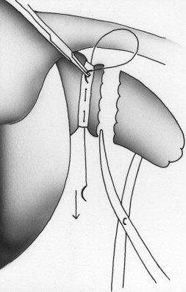
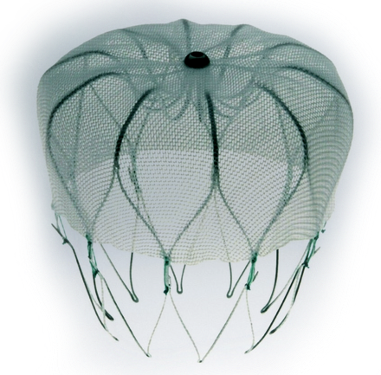
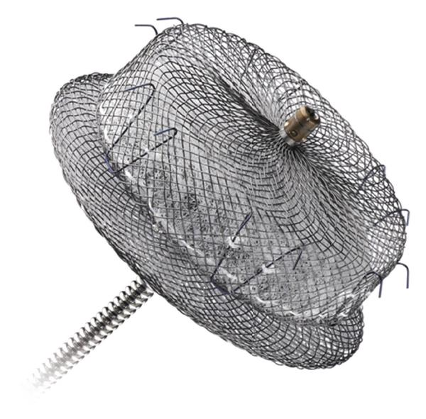
Stroke prevention methods
ALTERNATIVE METHODS
Left atrial appendage occlusion / exclusion
Peter Roth et al. The Pericardium-Reinforced Technique of Amputation of the Left Atrial Appendage: Quick, Safe, and Simple. The Annals of Thoracic Surgery, Volume 90, Issue 1 , Pages e11-e13, July 2010
2020 ESC Guidelines for the diagnosis and management of atrial fibrillation, Gerhard Hindrickset.al., European Heart Journal, Volume 42, Issue 5, 1 February 2021, Pages 373–498
Notes:
And LAAO has been shown to be effective in minimizing the stroke risk in AF patients.

Slide 7
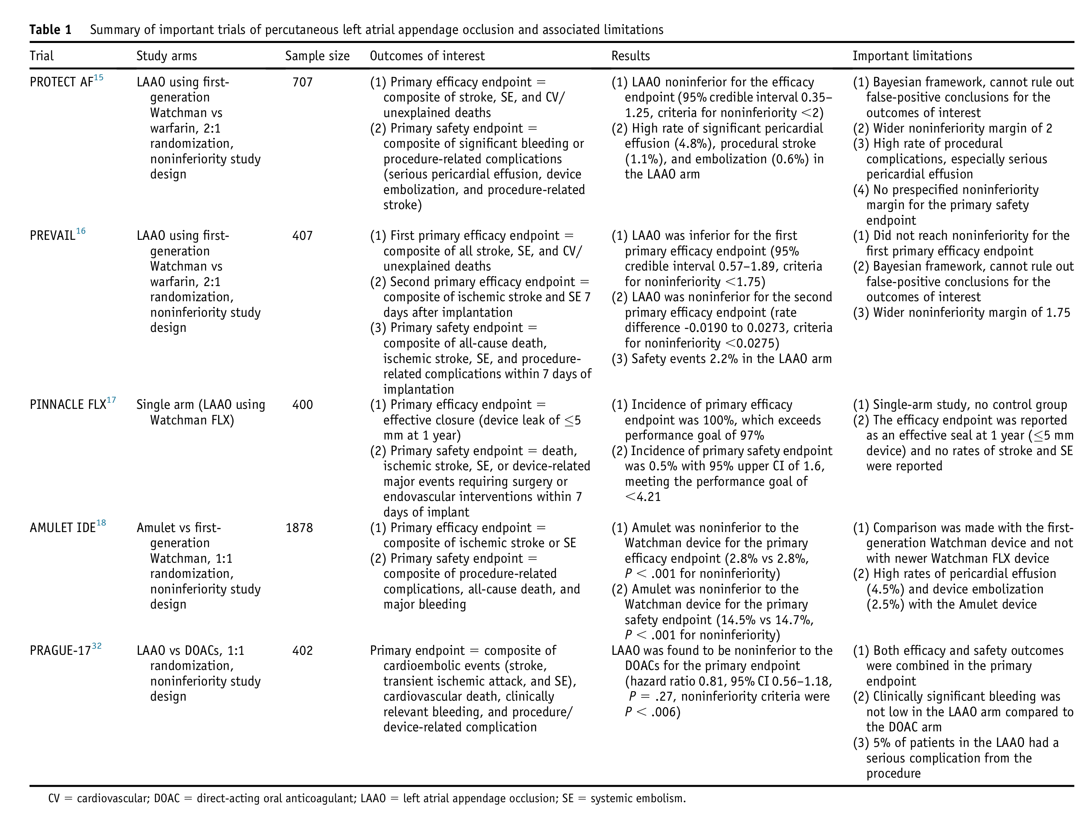
I - COMPARISON
Munir and Hsu, LAAO in Select AF Patients, HeartRhythm, VOLUME 3, ISSUE 4, P448-454, AUGUST 01, 2022
Notes:
The 2 currently approved endocardial devices used for occlusion are Watchman and Amplatzer Amulet.
The PROTECT AF and Prevail trials were the first randomized comparisons between device and warfarin. A meta-analysis including patient-level data from PROTECT AF and PREVAIL trials and their registries demonstrated that the Watchman device was noninferior to warfarin for prevention of stroke/systemic thromboembolism, and was associated with a significantly lower risk of hemorrhagic stroke, nonprocedure related major bleeding and mortality at 5-year follow-up.
The more recently conducted PINNACLE FLX trial further demonstrated the safety and efficacy of the new-generation Watchman FLX device.
The Amulet IDE trial also showed noninferiority of the Amplatzer Amulet device in reducing the stroke risk compared to the first generation Watchman device.

Slide 8
Stroke prevention methods
ANTICOAGULANTS
Recommendations for the prevention of thromboembolic events in AF
2020 ESC Guidelines for the diagnosis and management of atrial fibrillation, Gerhard Hindrickset.al., European Heart Journal, Volume 42, Issue 5, 1 February 2021, Pages 373–498
Notes:
But what about the DOACs. As you know, the last decade DOACs widely assimilated into clinical practice and they are considered as a first-line therapy for stroke risk reduction. There are limited randomized data on head-to-head comparison of DOACs with LAAO devices.

Slide 9
I - COMPARISON
Rivaroxaban, Apixaban, Dabigatran
Amulet,
Watchman,
Watchman-FLX
Notes:
Recently, the 4-year folloow up data from PRAGUE-17 trial was published. Where more than 400 AF patients randomized to DOACs and occluder group. The primary endpoint of the trial was a composite of cardioembolic events, cardiovascular death, clinical relevant bleeding and procedure related complications.
In this trial, devices was found to be noninferior to the DOACs for the primary endpoint

Slide 10
I - COMPARISON
Rivaroxaban, Apixaban, Dabigatran
Amulet,
Watchman,
Watchman-FLX
Results:
LAAO was found to be noninferior to the DOACs.
Limitattion:
Efficacy and safety outcomes were combined in the primary endpoint;
Clinically significant bleeding was not low in the LAAO group compared to the DOACs;
5% of patients in the LAAO had a serious complication from the procedure.
Ongoing Trials
CHAMPION-AF
CATALYST
Occlusion-AF
Osmancik, P. Et al. J Am Coll Cardiol. 2020; 75(25):3122-35.
Notes:
In this trial primary endpoint was composed both efficacy and safety outcomes. and trial didn’t demonstrate any safety advantages of devices with respect to DOACs, as clinically significant bleeding was not better in the device arm and approximately 5% of patients had a serious complication after device implantation.
Currently 3 large trials are being conducted that will evaluate the efficacy and safety of device implantation with DOACs. These trials will adjudicate safety outcomes with a superiority design framework.

Slide 11
Stroke prevention methods
ALTERNATIVE METHODS
Left atrial appendage occlusion / exclusion
Peter Roth et al. The Pericardium-Reinforced Technique of Amputation of the Left Atrial Appendage: Quick, Safe, and Simple. The Annals of Thoracic Surgery, Volume 90, Issue 1 , Pages e11-e13, July 2010
2020 ESC Guidelines for the diagnosis and management of atrial fibrillation, Gerhard Hindrickset.al., European Heart Journal, Volume 42, Issue 5, 1 February 2021, Pages 373–498
Notes:
LAAO currently recommended in AF patients with elevated stroke risk, and contraindications to long-term anticoagulation treatment (class IIb, level of evidence B) [1,2]. The guidelines suggest that patients with a history of bleeding without reversible cause should be considered for LAAC

Slide 12
Stroke prevention methods
What kind of OAC contraindication do we have?
Notes:
Ok, what are these contraindications to long-term anticoagulation treatment?

Slide 13
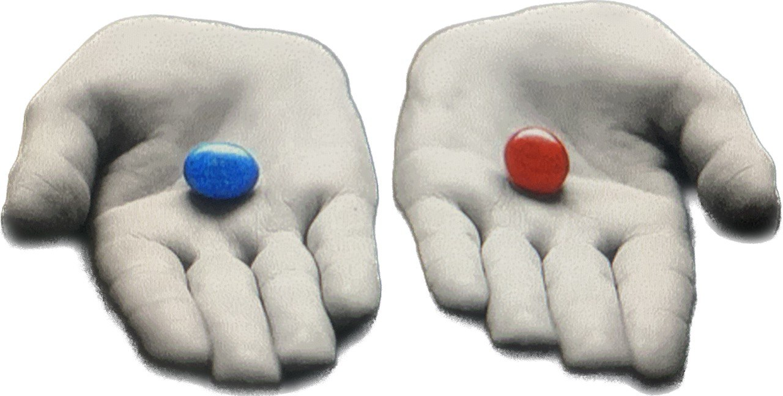
TOUGH CALL,
WHY?
A
B
C
A “tough call” simply means a difficult decision.
OACs
OCCLUSION
Notes:
Unfortunately, there is only limited evidence regarding different indications for occluders and their effects on procedural and long-term outcomes in daily clinical practice for special subgroups of patients. That’s why next statements should be accepted as perspectives for using LAAO devices.

Slide 14
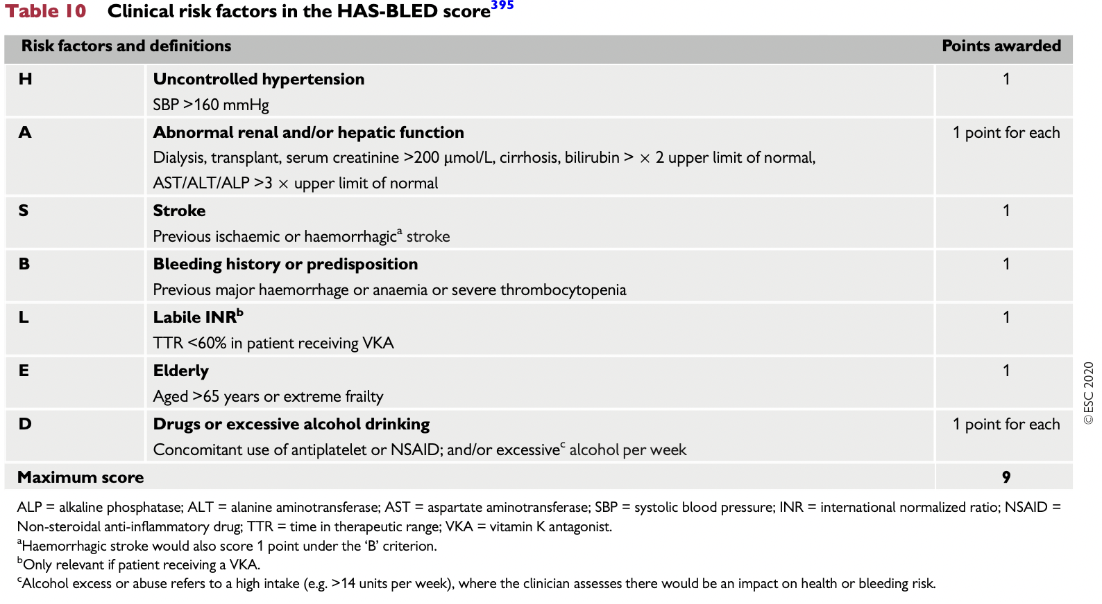
Perspectives for using LAAO devices
A
B
C
Non-modifiable
Modifiable
2020 ESC Guidelines for the diagnosis and management of atrial fibrillation, Gerhard Hindrickset.al., European Heart Journal, Volume 42, Issue 5, 1 February 2021, Pages 373–498
Notes:
For bleeding risk assessment, the HAS-BLED score help us to identify patients potentially at high risk of bleeding.
The management of anticoagulation in patients with CKD and ESRD is challenging, as these patients have simultaneous increased risk of bleeding as well as stroke.

Slide 15
Perspectives for using LAAO devices
Cautions and contraindications for using NOACs
2020 ESC Guidelines for the diagnosis and management of atrial fibrillation, Gerhard Hindrickset.al., European Heart Journal, Volume 42, Issue 5, 1 February 2021, Pages 373–498
Notes:
Most of the DOACs undergo some degree of renal clearance, thus making their pharmacokinetics unpredictable in patients with CKD and ESRD.

Slide 16
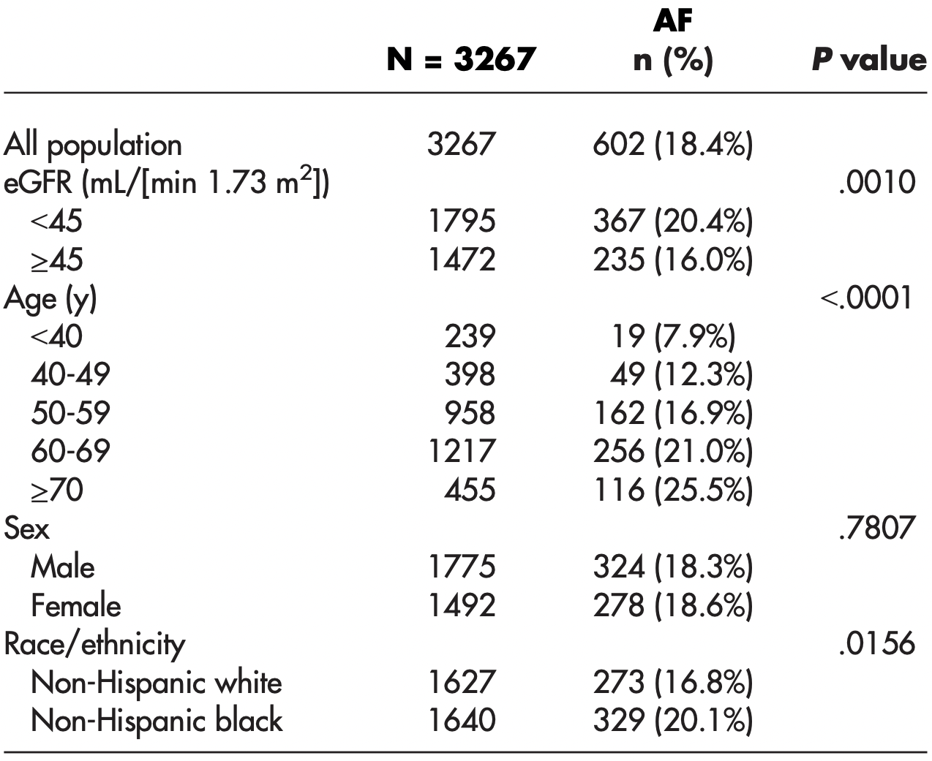
Perspectives for using LAAO devices
A
B
C
Chronic Kidney Disease (CKD)
End-Stage Renal Disease on Hemodialysis (ESRD + HD)
Prevalence of history of atrial fibrillation (AF) at DOPPS enrollment by region and age in prevalent cross-sections combining DOPPS I (1996–2001) and DOPPS II (2002–2004) (n=17,513).
Prevalence of atrial fibrillation (AF) by eGFR, age, sex and race.
Soliman EZ, Prineas RJ, Go AS, et al. Chronic Renal Insufficiency Cohort (CRIC) Study Group. Chronic kidney disease and prevalent atrial fibrillation: the Chronic Renal Insufficiency Cohort (CRIC). Am Heart J 2010;159:1102–1107
Wizemann V, Tong L, Satayathum S, et al. Atrial fibrillation in hemodialysis patients: clinical features and associations with anticoagulant therapy. Kidney Int 2010;77:1098–1106.
Notes:
Data from Chronic Renal Insufficiency Cohort shows that, 20% had evidence of AF, a prevalence similar to that reported among patients with end-stage renal disease and 2 to 3 times of that reported in the general population.

Slide 17
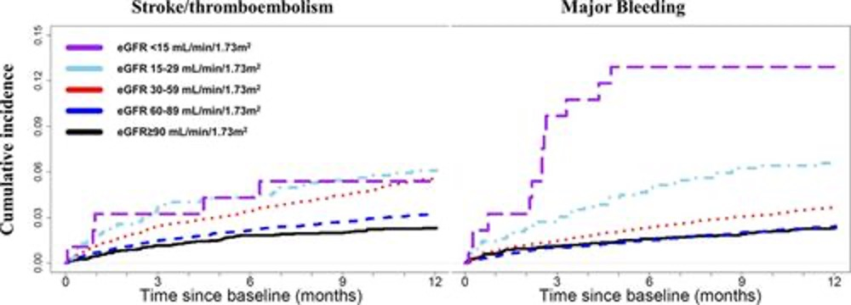
Perspectives for using LAAO devices
A
B
C
Stroke / thromboembolism
Major Bleeding
eGFR <15 mL/min/1.73m²
eGFR 15-29 mL/min/1.73m²
eGFR 30-59 mL/min/1.73m²
eGFR 60-89 mL/min/1.73m²
eGFR ≥90 mL/min/1.73m²
Cumulative incidence
0.00 0.03 0.06 0.09 0.12 0.15
0 3 6 9 12
0 3 6 9 12
Time since baseline (months)
Time since baseline (months)
Anders Nissen Bonde. Stroke. Renal Function and the Risk of Stroke and Bleeding in Patients With Atrial Fibrillation, Volume: 47, Issue: 11, Pages: 2707-2713, DOI: (10.1161/STROKEAHA.116.014422)
Notes:
Warfarin is the most studied oral anticoagulant in these groups of patients. In a large Danish cohort of AF patients, risk of stroke and major bleeding were significantly associated with the level of renal function. Warfarin treatment was associated with higher risk of bleeding in all eGFR groups.

Slide 18
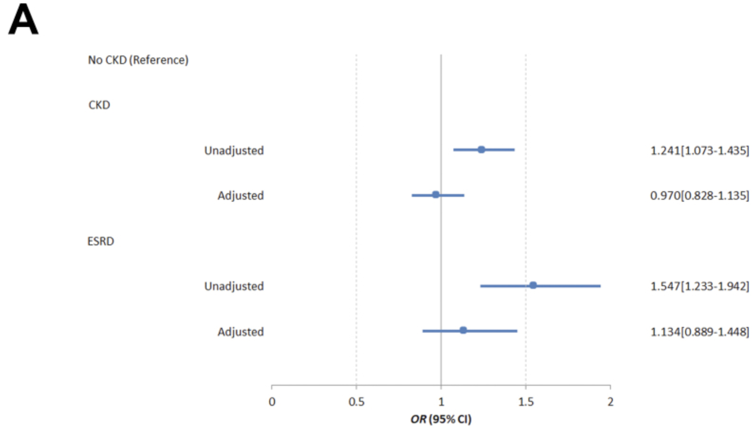
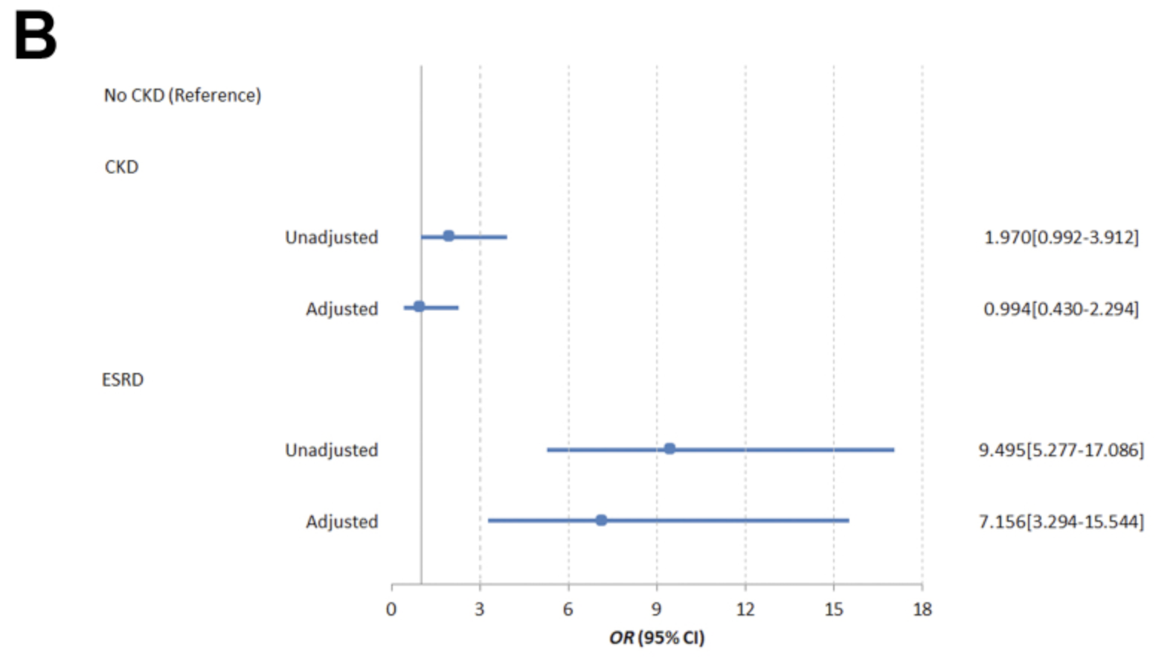
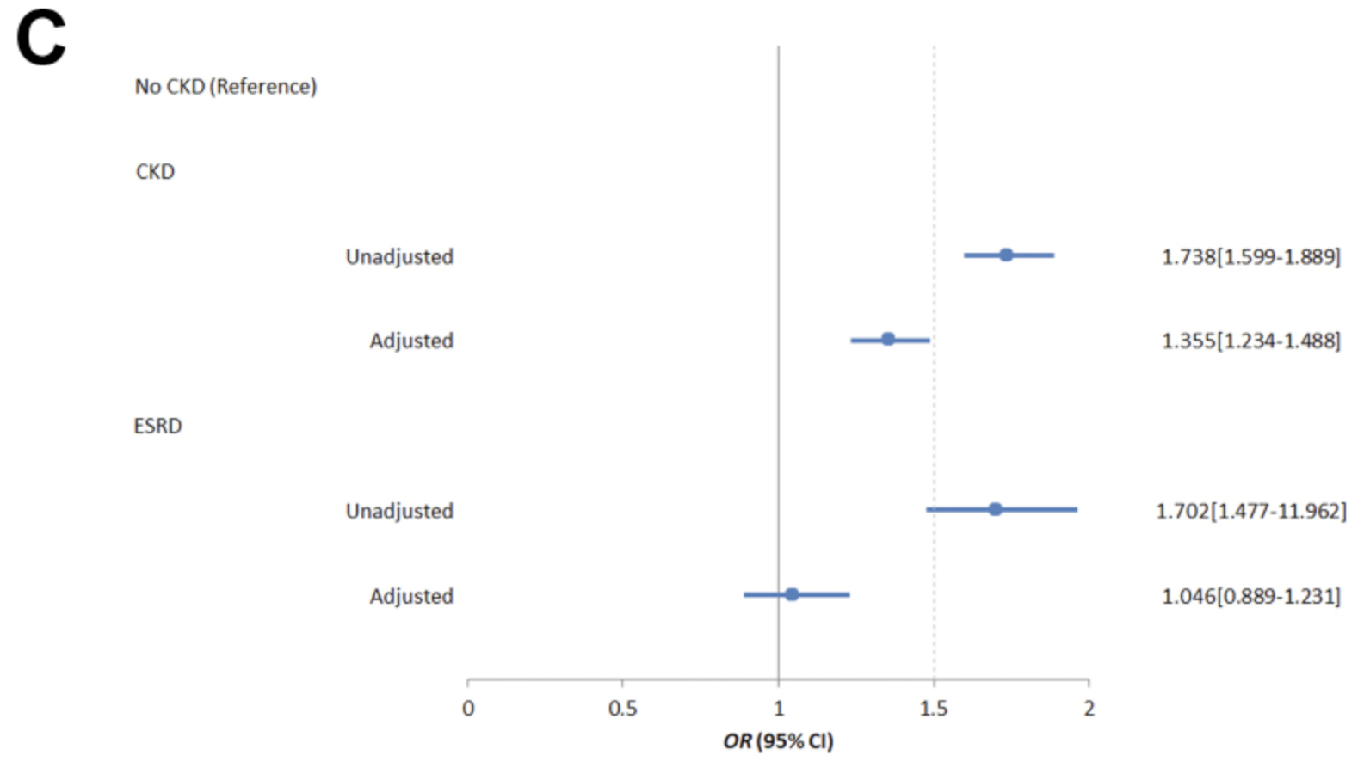
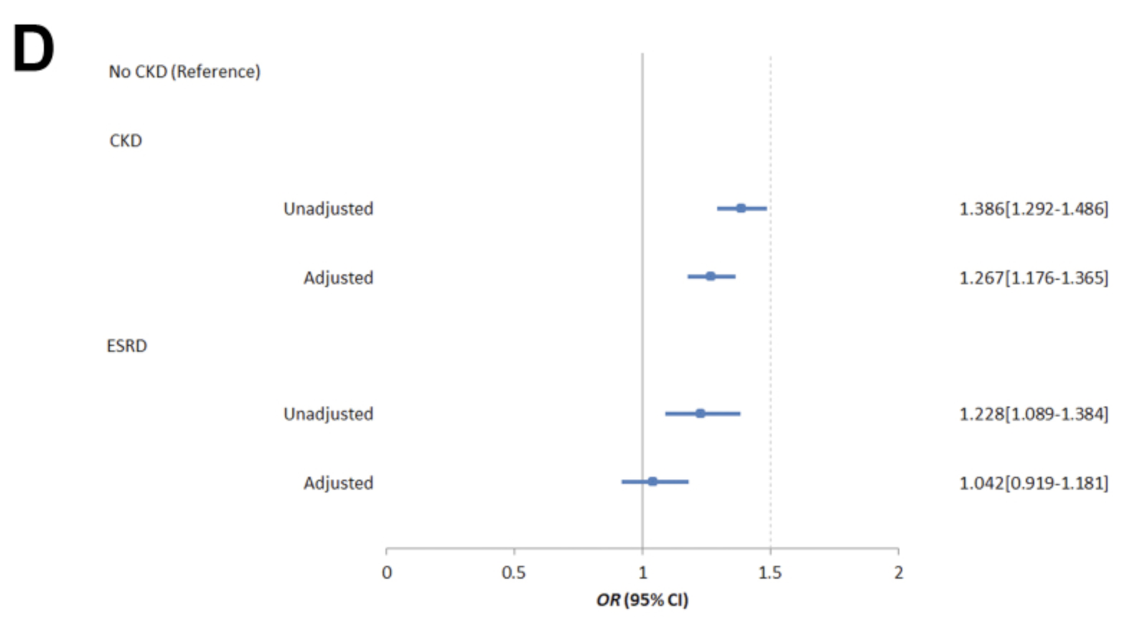
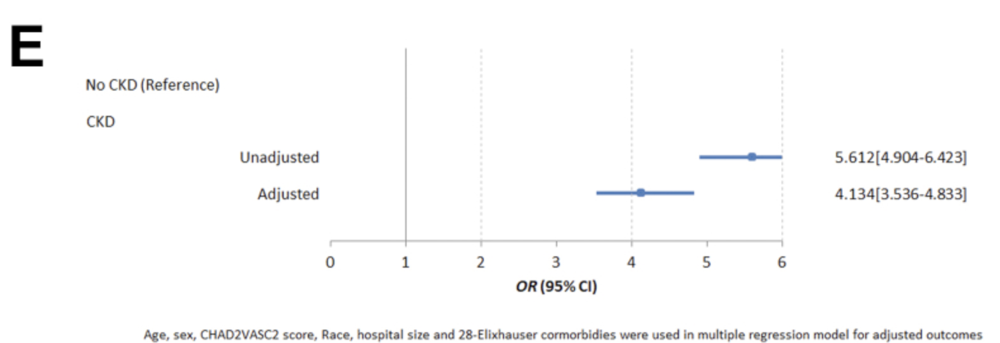
Perspectives for using LAAO devices
Cohort study from National Inpatient Sample
n=36 000, (patients with CKD and ESRD =13%)
Unadjusted and multivariable adjusted association of both chronic kidney disease (CKD) and end-stage renal disease (ESRD) (reference group no chronic kidney disease) with procedural outcomes including A: major complications; B: mortality; C: prolonged length of stay; D: hospitalization cost > median $24,663; and E: acute kidney injury.
Munir MB, Khan MZ, Darden D, et al. Association of chronic kidney disease and end-stage renal disease with procedural complications and in-hospital outcomes from left atrial appendage occlusion device implantation in patients with atrial fibrillation: insights from the national inpatient sample of 36,065 procedures. Heart Rhythm O2 2021;2:472–479.
Notes:
In a study of more than 36,000 LAAO device implantations (approximately 13% was patients with CKD and ESRD), the authors demonstrated that CKD was independently associated with prolonged length of stay and acute kidney injury while ESRD was independently associated with inpatient mortality.
The optimal stroke prevention strategy in patients with kidney disease is still controversial, and further large scale studies are needed before LAAO can be safely recommended in such patients.

Slide 19
Perspectives for using LAAO devices
2020 ESC Guidelines for the diagnosis and management of atrial fibrillation, Gerhard Hindrickset.al., European Heart Journal, Volume 42, Issue 5, 1 February 2021, Pages 373–498
Notes:
Another challenging patients subgroup are patients with history of stroke and bleeding.

Slide 20
Perspectives for using LAAO devices
Patinets with spontaneous Intracerebral Hemorrhage survive
1 year - 46.0 %
5 years - 29.2 %
Poon MTC, et al. J Neurol Neurosurg Psychiatry 2014;85:660–667. doi:10.1136/jnnp-2013-306476
Notes:
Less than a half of patients with ICH survive 1 year and less than a third survive 5 years.

Slide 21
Perspectives for using LAAO devices
A
B
C
Risks of recurrent intracerebral hemorrhage (ICH) and ischemic stroke after ICH
Poon MTC, et al. J Neurol Neurosurg Psychiatry 2014;85:660–667. doi:10.1136/jnnp-2013-306476
Notes:
ICH survivors with AF are at risk of ischaemic stroke, but also of recurrent bleeding. Systematic review and meta-analyzes shows that, risks of recurrent ICH and ischaemic stroke after ICH appear similar, provoking uncertainties about the use of antithrombotic drugs.

Slide 22
Perspectives for using LAAO devices
A meta-analysis of seven observational studies of AF patients who survived an ICH
n = 2452)
2020 ESC Guidelines for the diagnosis and management of atrial fibrillation, Gerhard Hindrickset.al., European Heart Journal, Volume 42, Issue 5, 1 February 2021, Pages 373–498
Notes:
Another meta-analysis of seven observational studies showed that in those patients who doesn’t taking any antithrombotic treatment, the rates of ischemic stroke were higher than the rates of recurrent ICH

Slide 23
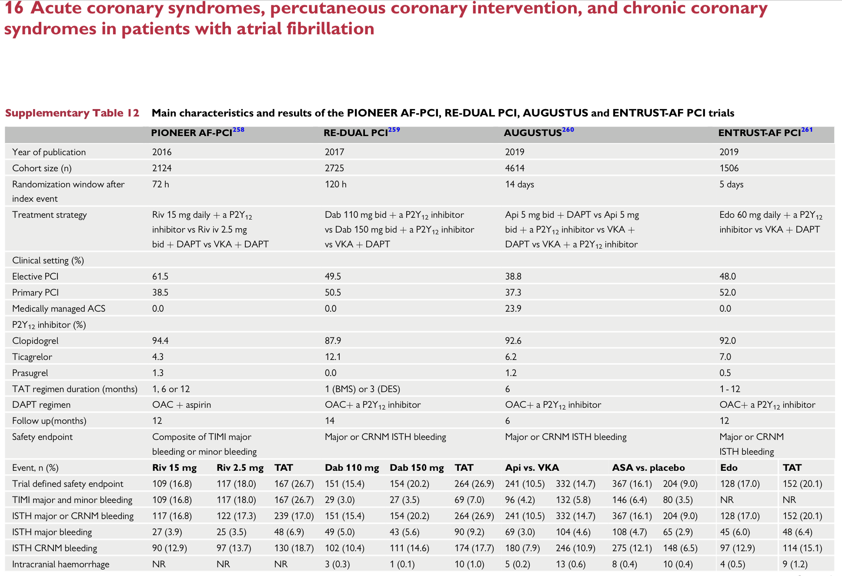
Perspectives for using LAAO devices
C
2020 ESC Guidelines for the diagnosis and management of atrial fibrillation, Gerhard Hindrickset.al., European Heart Journal, Volume 42, Issue 5, 1 February 2021, Pages 373–498
Notes:
Patients under the triple antithrombotic therapy are also at high risk of bleeding.

Slide 24
Perspectives for using LAAO devices
C
2020 ESC Guidelines for the diagnosis and management of atrial fibrillation, Gerhard Hindrickset.al., European Heart Journal, Volume 42, Issue 5, 1 February 2021, Pages 373–498
Notes:
There are no high-quality RCT data to inform optimal timing of OAC (re)start after ICH. Haematoma expansion, common in acute ICH, is aggravated by anticoagulation, which should be reversed and avoided in acute ICH (<24 - 48 h). A modelling analysis estimated that the overall risk of stroke and ICH was the lowest when OAC was (re)started 10 weeks after acute ICH, and a period of >_4 weeks was suggested.

Slide 25
Perspectives for using LAAO devices
HAS - BLED
Munir MB, Khan MZ, Darden D, et al. Association of advanced age with procedural complications and in-hospital outcomes from left atrial appendage occlusion device implantation in patients with atrial fibrillation: insights from the National Inpatient Sample of 36,065 procedures. J Interv Card Electrophysiol 2022 Jun 22;
Notes:
Another challenging patients subgroup are elderly patients.
In elderly patients, stroke related to AF are generally more disabling. Additionally, elderly patients are more susceptible to major bleeding when OACs are used for the reduction of stroke risk. Unfortunately, the trials evaluating the efficacy and safety of device implantation included fewer elderly patients.

Slide 26
HAS - BLED
Observational study
n= 36,065
35% Patients > 80 y.o.
Firs generation of Watchman device
Elderly AF patients had a higher prevalence of major complications (6.7% vs. 5.7%, p < 0.01) and mortality (0.4% vs. 0.1%, p < 0.01) after LAAO device implantation in the crude analysis.
Munir MB, Khan MZ, Darden D, et al. Association of advanced age with procedural complications and in-hospital outcomes from left atrial appendage occlusion device implantation in patients with atrial fibrillation: insights from the National Inpatient Sample of 36,065 procedures. J Interv Card Electrophysiol 2022 Jun 22;
Notes:
In a study of 36 065 patients undergoing device implantation, Munir and collegues showed that Elderly AF patients had a higher prevalence of major complications (6.7% vs. 5.7%, p < 0.01) and mortality (0.4% vs. 0.1%, p < 0.01) after LAAO device implantation in the crude analysis.

Slide 27
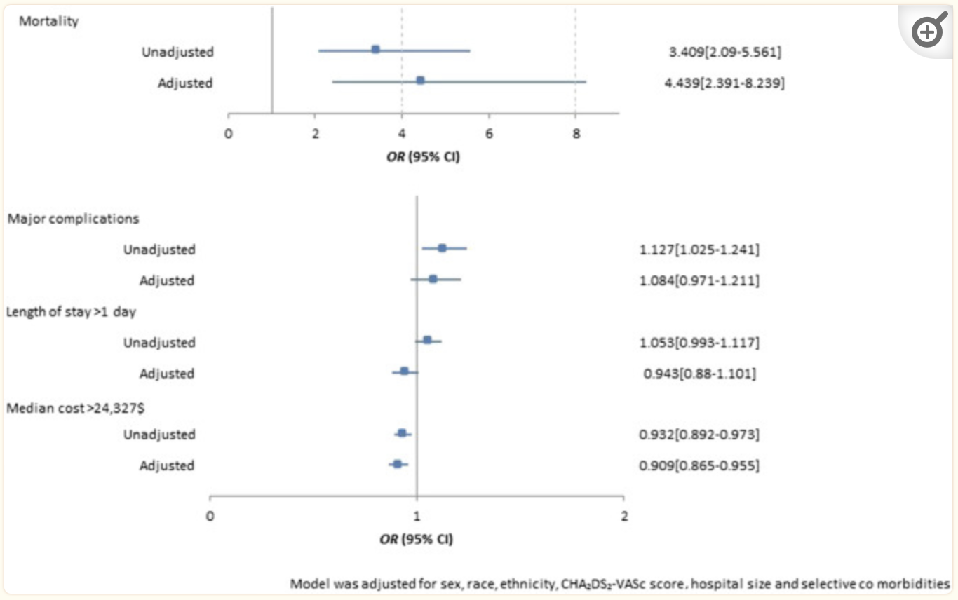
HAS - BLED
Unadjusted and adjusted associations of age > 80 years with outcomes of mortality, major complications, prolonged length of stay, and increased hospitalization costs in patients undergoing percutaneous left atrial appendage occlusion
Munir MB, Khan MZ, Darden D, et al. Association of advanced age with procedural complications and in-hospital outcomes from left atrial appendage occlusion device implantation in patients with atrial fibrillation: insights from the National Inpatient Sample of 36,065 procedures. J Interv Card Electrophysiol 2022 Jun 22;
Notes:
But, After adjusting for potential confounding variables, advanced age was associated with inpatient mortality, but not with other procedure–related outcomes including major complications, prolonged length of stay, or increased hospitalization costs.

Slide 28
Last but not least.

Slide 29
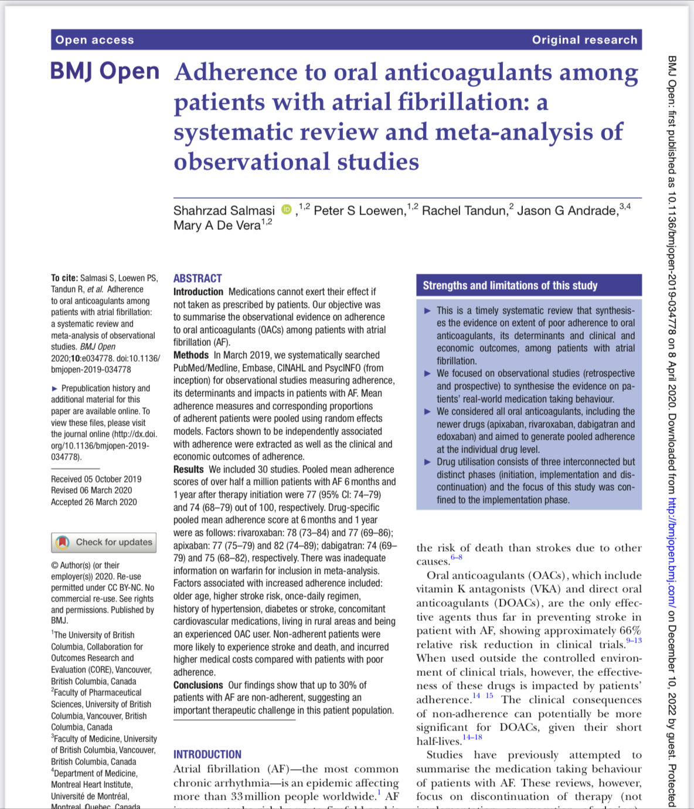
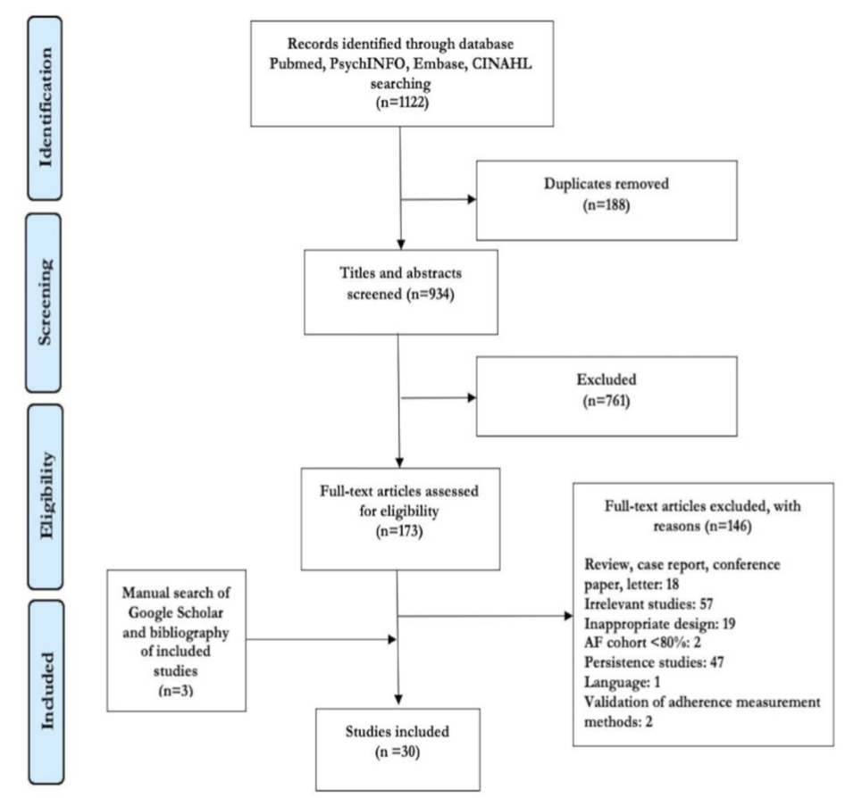
Patien compliance
Systematic reviews and Meta-Analyses flow diagram that details the number of studies identified by our search strategy screened and included in the final analysis
Notes:
There are countless factors that lead to patients not complying with this treatment such as numerous trips to the hospital, as well as the waiting time for consultation, their pathology, drug interactions, and personal beliefs. Thus, therapeutic doses are sometimes altered or interrupted by the patient. Shahrzad Salmasi and colleagues focused on observational studies (retrospective and prospective) to synthesise the evidence on patients’ real-world medication taking behaviour. They considered all oral anticoagulants, including the newer drugs and aimed to generate pooled adherence at the individual drug level. They included 30 studies.

Slide 30
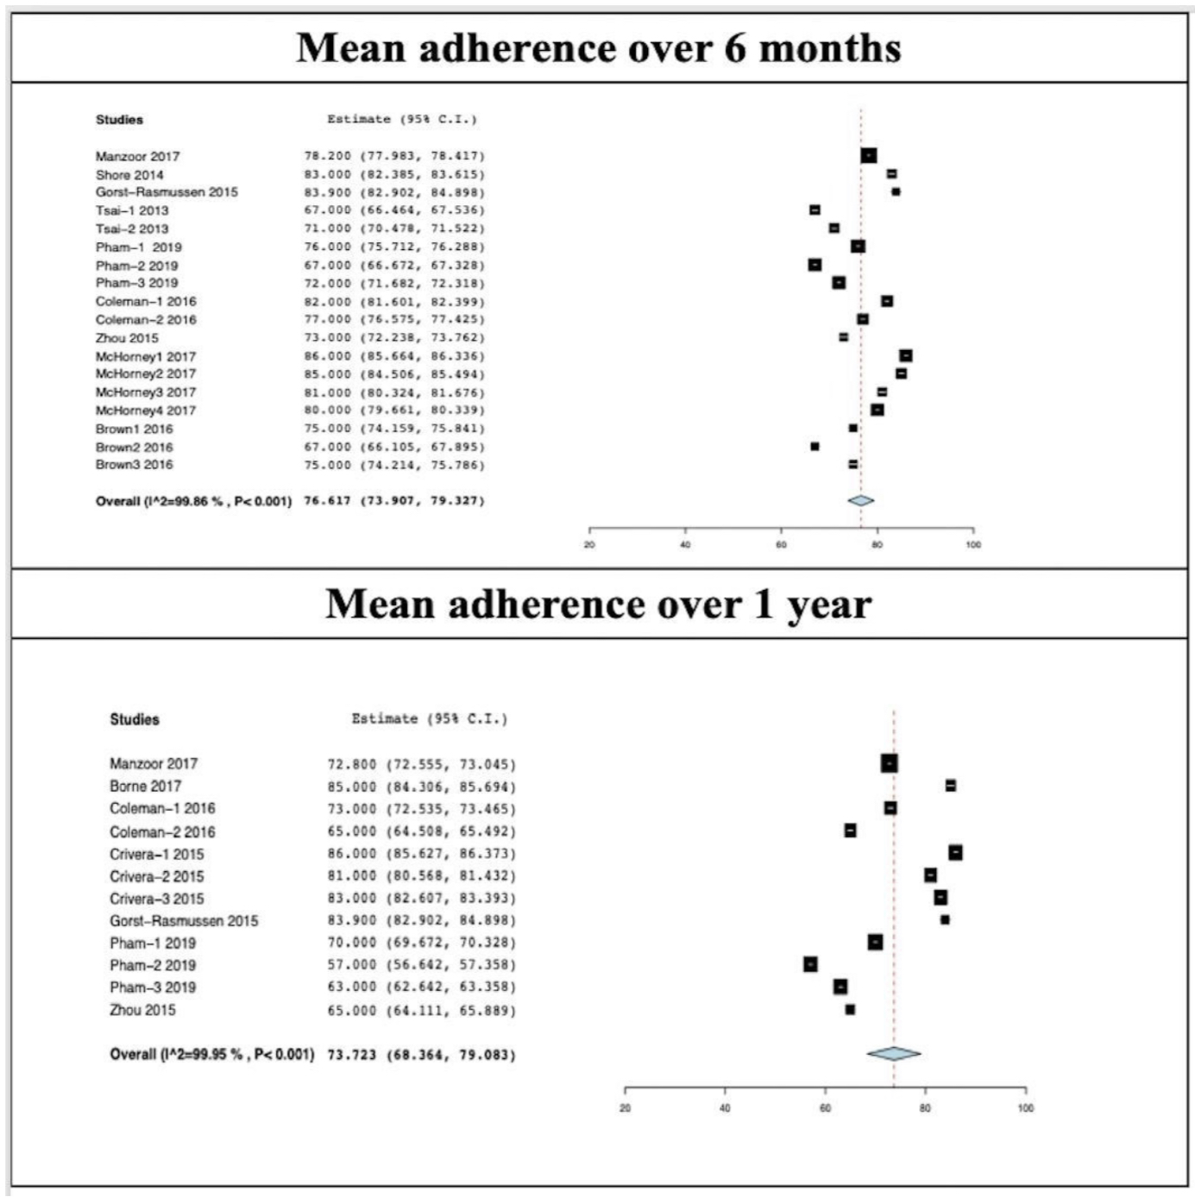
Results
Conclusion
up to 30% of patients with AF are non-adherent, suggesting an important therapeutic challenge in this patient population
Notes:
Pooled mean adherence scores of over half a million patients with AF 6 months and 1 year after therapy initiation were 77 (95% CI: 74–79) and 74 (68–79) out of 100, respectively.

Slide 31
CONCLUSION
Percutaneous LAAO is an attractive alternative to OACs for reduction of stroke risk in AF patients.
Much progress has been made over the last decade in making percutaneous LAAO safer and more effective for a significant proportion of patients with AF.
Because of robust data supporting OACs in reducing stroke risk in most AF patients, and lacking data regarding extending LAAO to all AF populations, LAAO should not be considered the primary therapy for all AF patients
Procedure should be reserved for patients with heightened stroke risk and contraindications to long-term OACs.
Notes:
LAAO is an attractive alternative to OACs for reduction of stroke risk in AF patients.
Much progress has been made over the last decade in making LAAO safer and more effective for a significant proportion of patients with AF.
Procedure should be reserved for patients with heightened stroke risk and contraindications to long-term OACs.

Slide 32
THANK YOU

